Slide 1



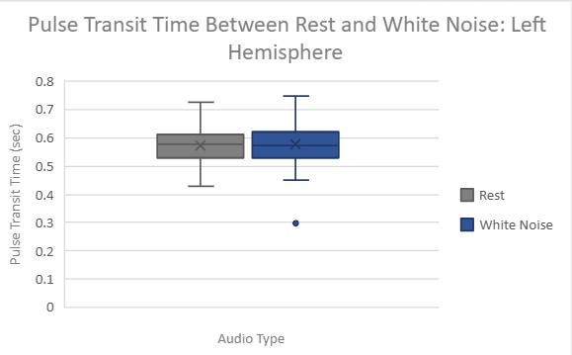
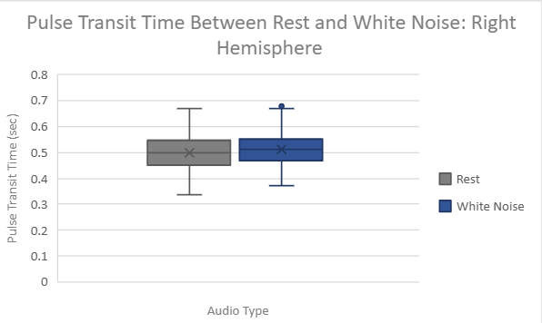
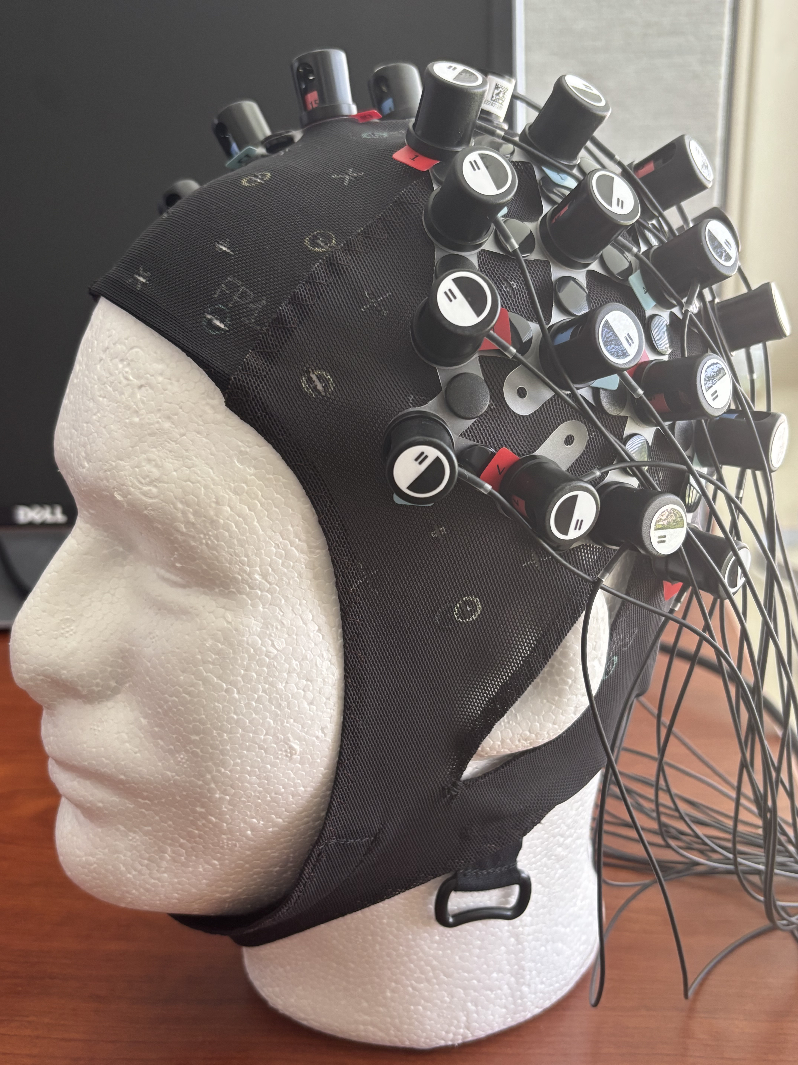
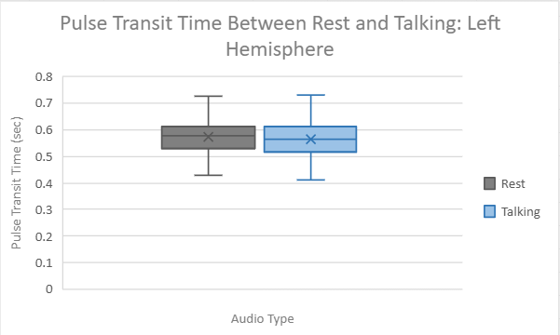
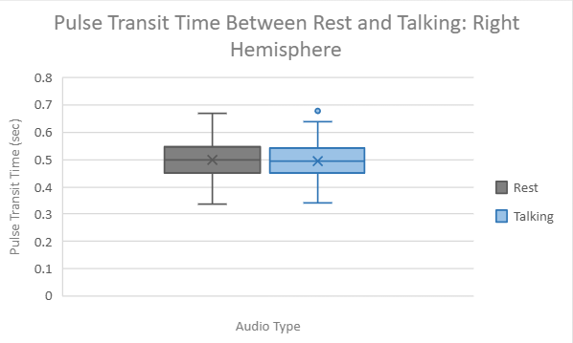
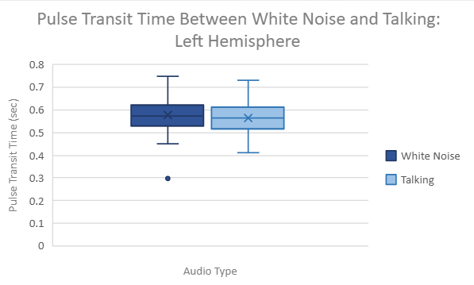
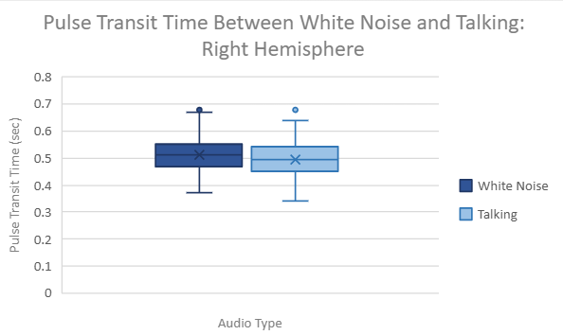
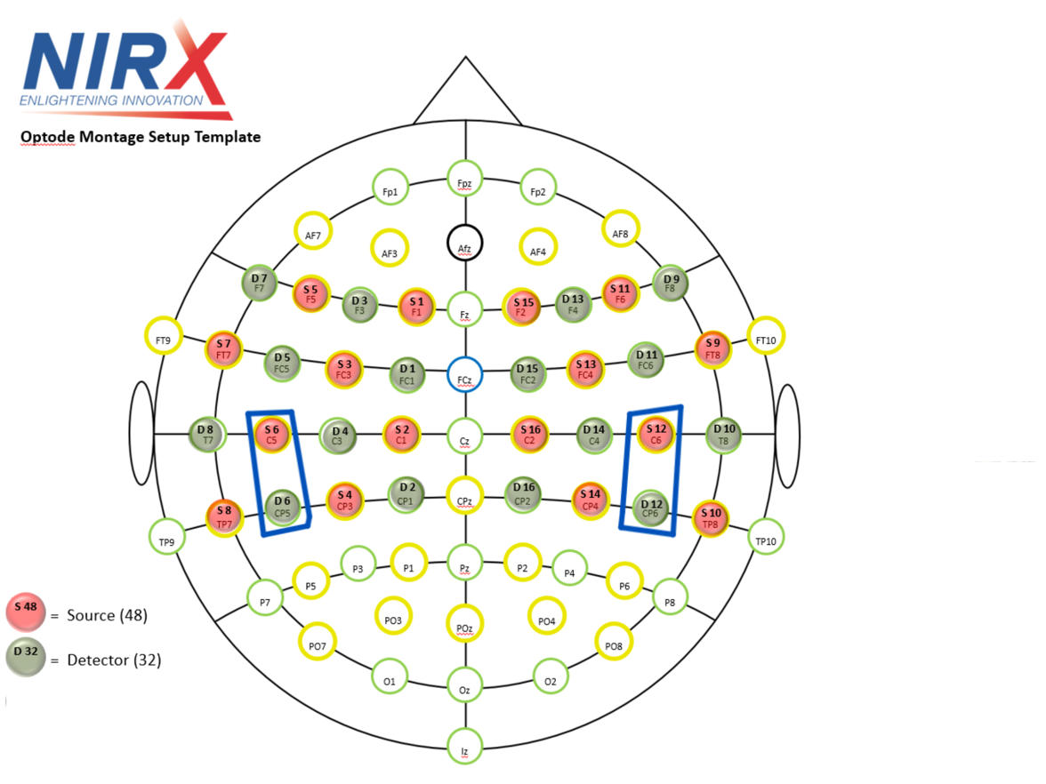
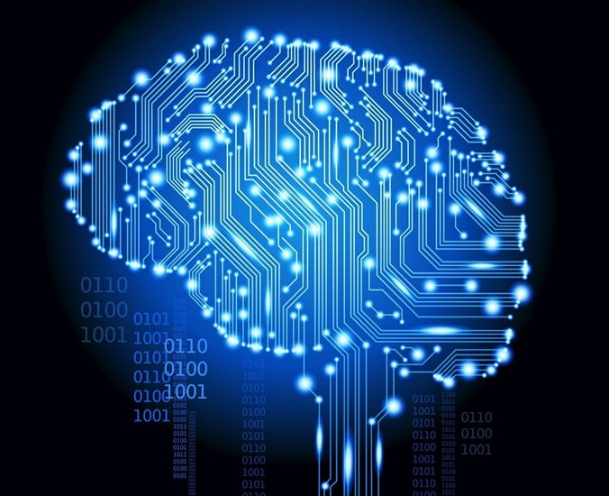
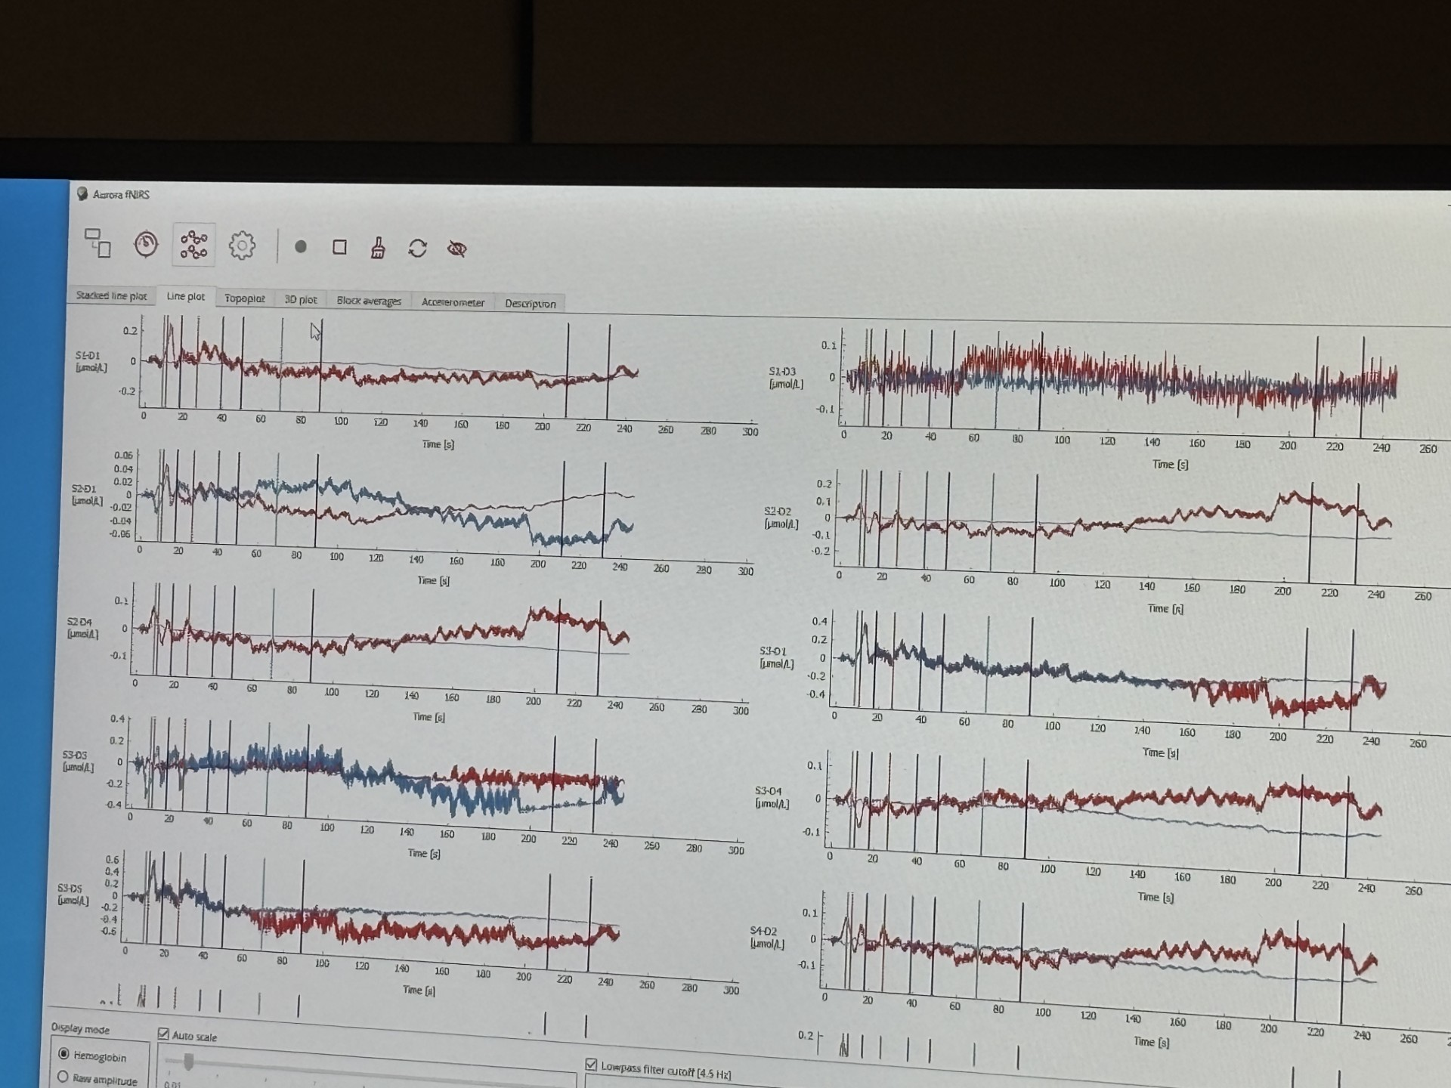
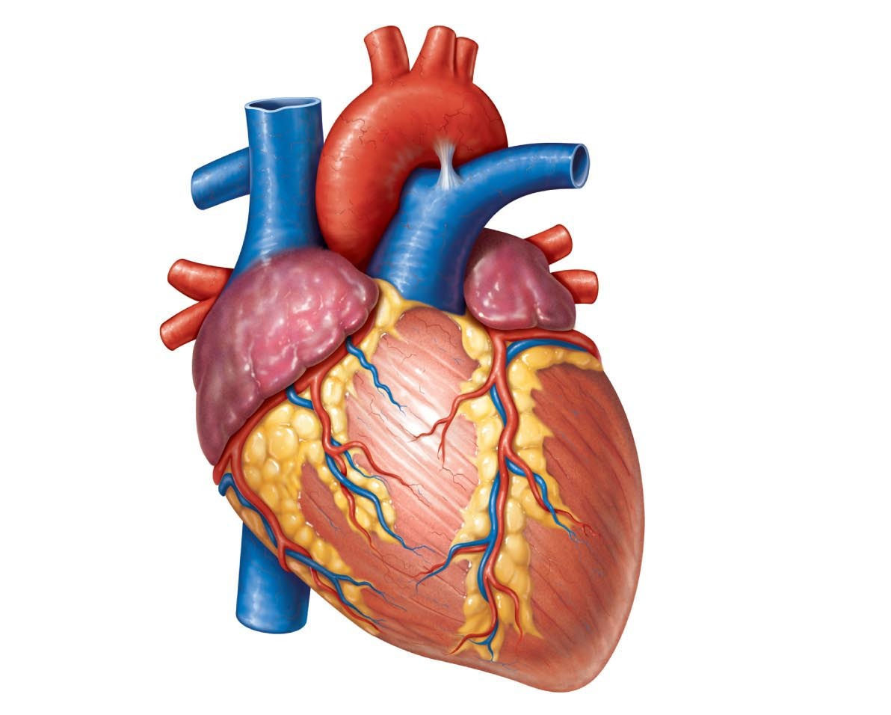
New Methods for Brain Computer Interfaces
Nyla Heeter, Dr. Gregory Lewis, Phenzi Blasio, Logan Holmes
nyheeter@iu.edu
Introduction
Figures below represent two of the forty-eight channels that recorded fNIR's optode signals. They are the same position on different brain hemispheres, where Channel 18 shows left hemispheric activity and Channel 35 shows readings from the right hemisphere.
Researchers at the Socioneural Physiology Lab have learned a great deal from collecting this preliminary data. Regarding which markers we need to remove from the Python script, where we want collect data from future participants, and how to account for the time delay between fNIR and ECG readings. We are working to find more participants and improve our data collection methods currently.
Polyvagal Theory is a three-part concept suggesting an evolutionary connection between the heart and brain that enables humans to assess environmental safety.
This connection's origin was identified as a divergence in the vagus nerve, which sparked an interested among the scientific community in studying vagal activity
My research examines vagal pathways through analysis of superimposed functional near-infrared spectroscopy (fNIR) and electrocardiogram (ECG) data to find an alternative method for calculating pulse-transit times (PTT) using the R-wave of the ECG complex.
This longitudinal study focused on recordings from the brain’s auditory center to also explore how white noise and language influence vagal activity.
It was hypothesized that white noise would trigger bilateral hemispheric activity. While playing audio from the complex listening environment would only increase PTT in the left hemisphere because hearing in most humans in right ear dominant, and the brain is controlled through hemispheric lateralization.
Results
Future Work
T-Test = 1.0396
*T-Test = 2.9400
To eventually turn this neuroscience experiment into an engineering experiment where we create a wearable sensor similar to fNIR, we intend to identify consistent trends in the way naturalistic tasks impact PTT. This device will be less sensitive to movement than fNIR.
Both graphs above show increased PTT when white noise was played.
T-Test = 1.1858
T-Test = 0.6119
The Role of Non-Inclusive Technology
Participants were originally a forty-three-year-old white male with grey, black 1C hair and an eighteen-year-old black female with dark brown 3C hair. However, low optimization readings for the latter participant's fNIR made it difficult to interpret waves for calculating pulse-transit-times. Not using a diverse subject population happens frequently in fNIR research because its technology isn't suited for people of color. fNIR caps and tools don't account for the extra width thick hair adds to circumference measurements for subjects of color.
I recommend the following to NIRx, in hopes of promoting inclusive findings in future Neuroscience research:
A guide for scientists advising data collection on participants with thick hair
The development of a wearable device that records signals without near-infrared light
Methods/Materials
In our investigation, we used a combination of software and hardware to create a six-block, seventeen-minute-long experiment. In each block, white noise and people speaking English in a complex listening environment was played for twenty seconds each with sixty second rests between each block. The sections representing audio/the absence of audio were separated in the ECG and fNIR pulses through color-coded experimental markers. Markers were divided into rest blocks with no sound, white noise blocks, and talking/ ''complex listening environment'' blocks.
For the ECG Setup:
Acqknowledge software
Biopac MP160 System
For the fNIR Setup:
Aurora software
NIRx NirSport2 System
58-centimeter fNIR cap
For Experimental Analysis
and Development:
MATLAB Software
Python Version 1.3
The graphs above display decreased PTT from rest to when the talking audio played.
*T-Test = 4.8615
*T-Test = 3.194
Both graphs above display white noise PTT was consistently higher than talking PTT.
Conclusions
Acknowledgements
As researchers expected, bilateral hemispheric increase in PTT was triggered once the white noise was played. PTT decreased bilaterally with the talking audio, although it was projected to only be impacted in the left hemisphere because human hearing is right-ear dominant. This change in the entire brain is an aspect researchers want to explore in future subjects. However, based on participant one, it's believed that this was caused by extra noise coming from the lab room. T-values ranged from approximately 0.6 to 4.9. Thus, suggesting there’s a moderate possibility of result trends being random chance.
Thank you to Professor Emeritus Bennett Bertenthal for his funding support for the fNIR equipment used in this study.
Thank you to The Socioneural Physiology Lab staff at the Kinsey Institute for their kindness and support.

